Slide 1

Customer Retention
Guided By:
Shubham Yadav
Presented By:
Gokula Krishnan R

Slide 2
CUSTOMER RETENTION
Service Quality
Information Quality
Trust
Benefit
System Quality
ABSTRACT
Customer retention refers to the ability of a company or product to retain its customers & turn customers into repeat buyers and prevent them from switching to a competitor.
Five major factors that contributed to the success of an e-commerce store:

Slide 3
INTRODUCTION
Customer retention means the process of maintaining or keeping customers once you have acquired them. The goal is to build a long-lasting relationship between the brand and consumers. Once a customer becomes loyal to your brand, not only he/she will buy more from you than a normal customer but he’ll spread good words about your business, increase your reputation.
Customer retention is most important for every business, but it's especially significant for ecommerce organizations. After all, with an online business, you lack the opportunity to connect with customers. This inability to build face-to-face relationships can cause customer churn. When we come to know about online shopping we know that now a days it’s a part of human life.
Due to online shopping people can buy anything by sitting at their home. Due to rapid growth of technology, business organizations have switched over from the traditional method of selling goods to electronic method of selling goods. Business organizations use internet as a main vehicle to conduct commercial transactions.

Slide 4
EXPERIMENTAL SET UP
Hardware requirements:-
1. Processor — core i5 and above
2. RAM — 8 GB or above
3. SSD— 250 GB or above
Software requirements:-
1. ANACONDA

Slide 5
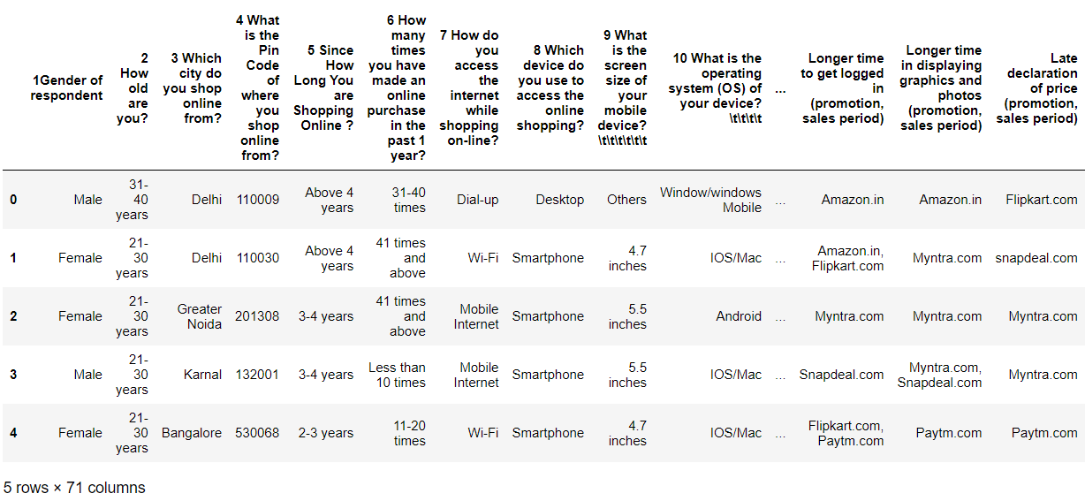
DATA PREPRATION
With the help of Pandas Library We will upload our data to Jupyter Notebook.
Once our data is uploaded with the help of predefined method (i.e. read_excel) we can read data for further processing.
We have two type of variables in the data:-
Dependent Variable
Independent Variable

Slide 6
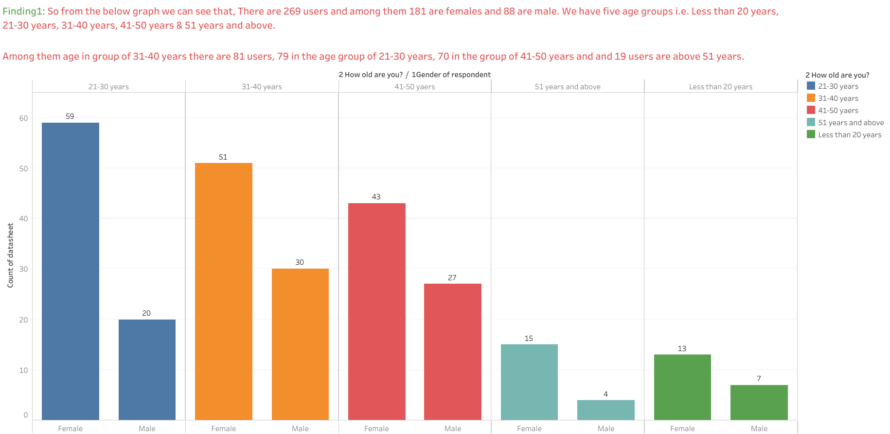

Slide 7
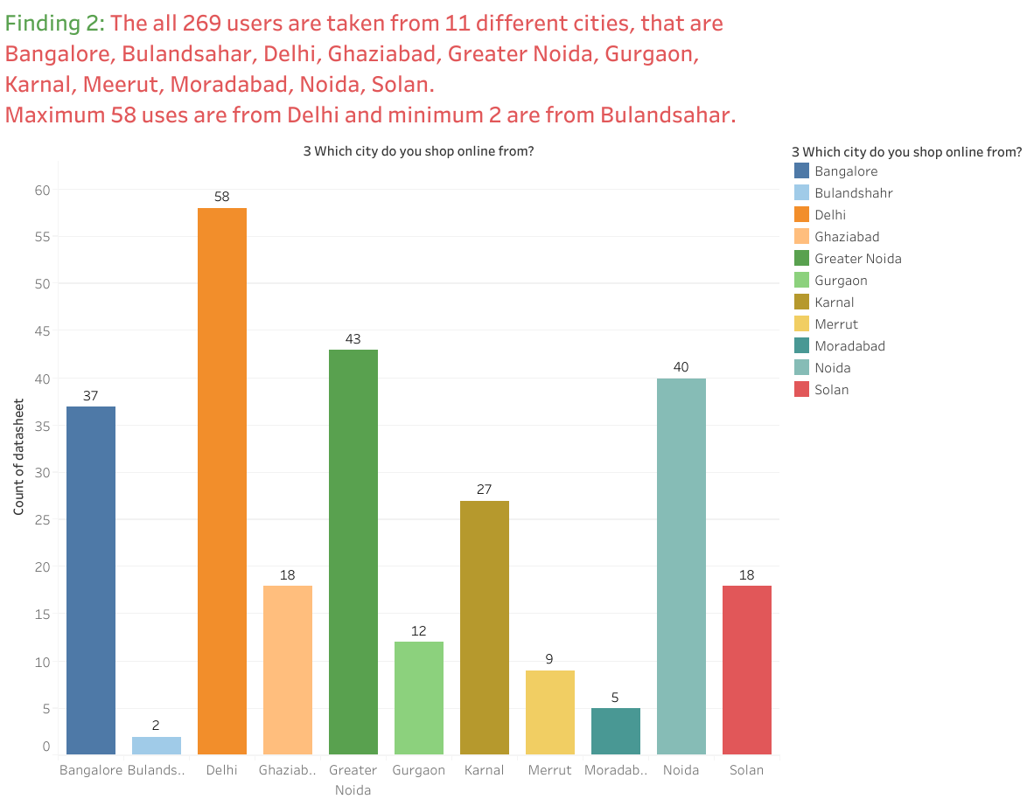

Slide 8
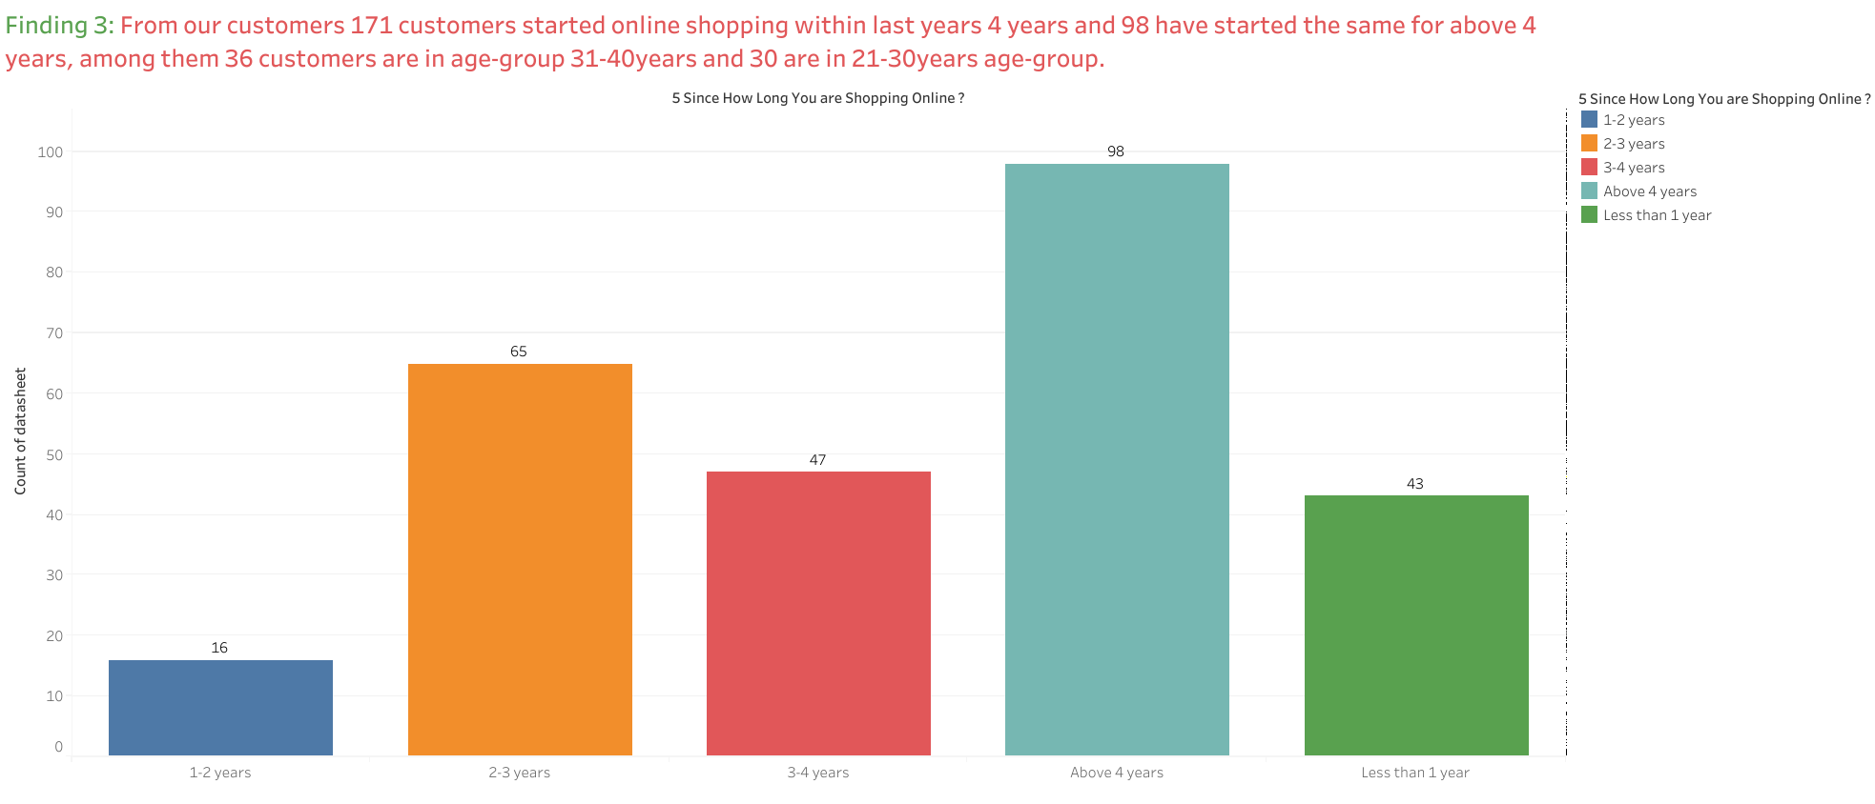

Slide 9
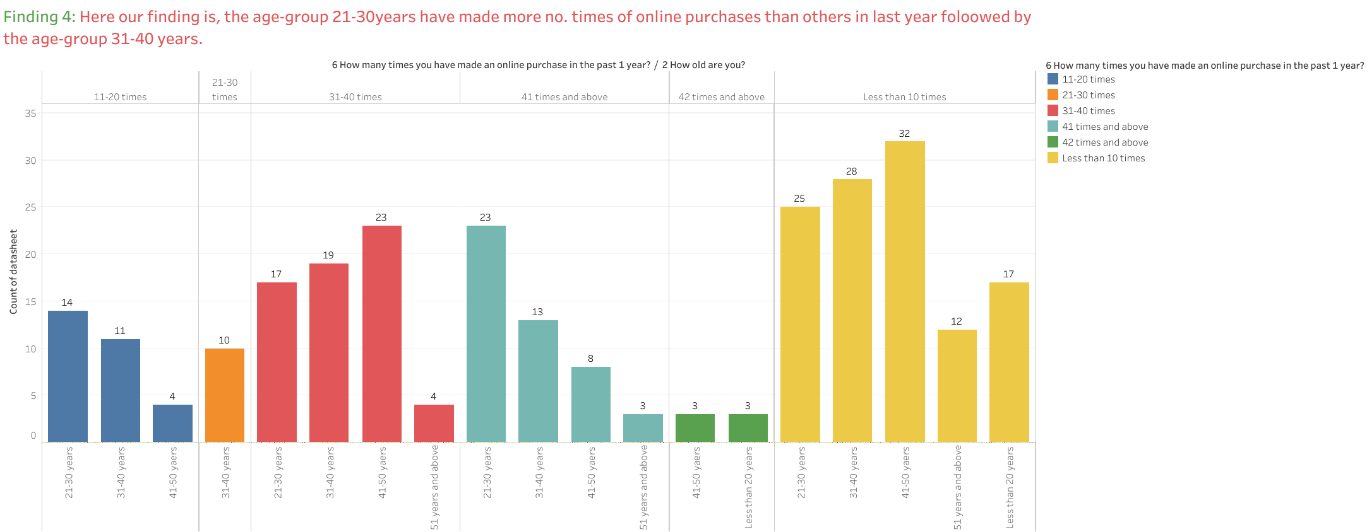

Slide 10
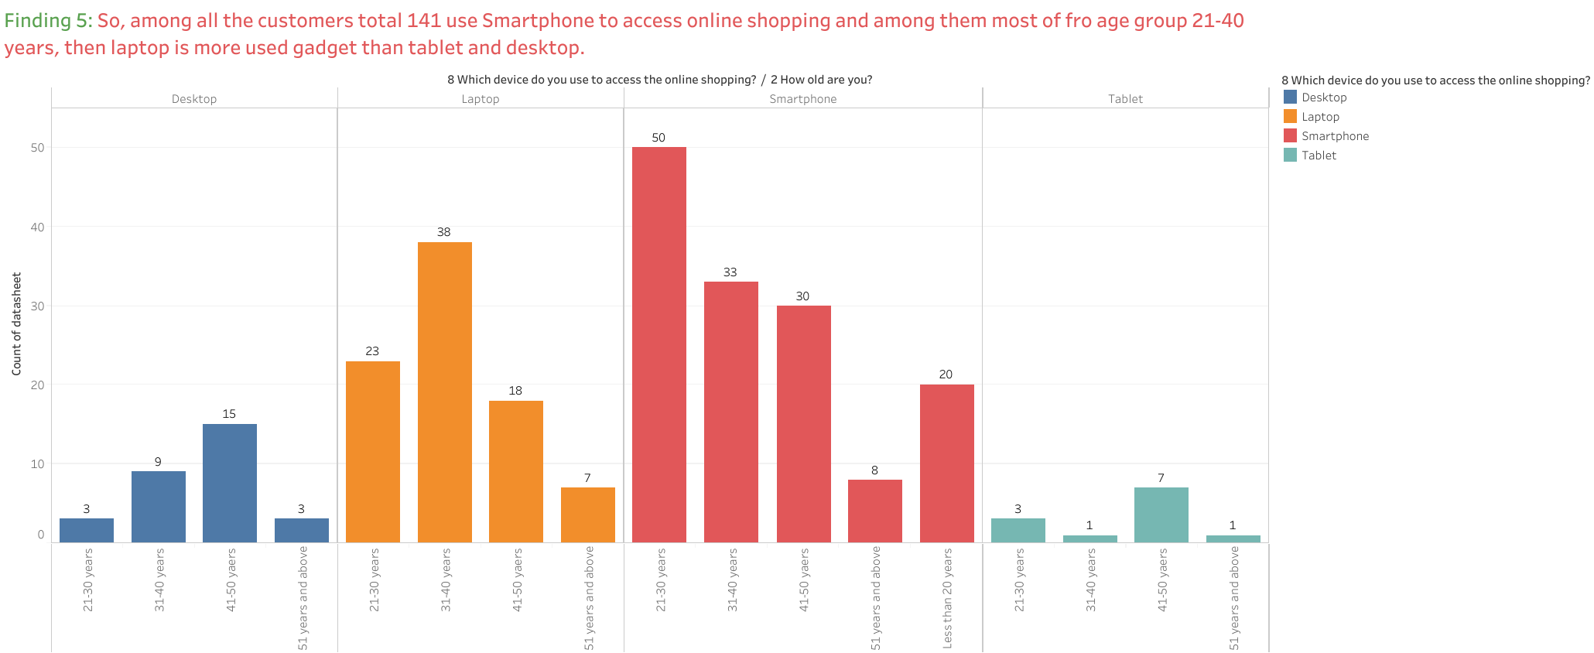

Slide 11
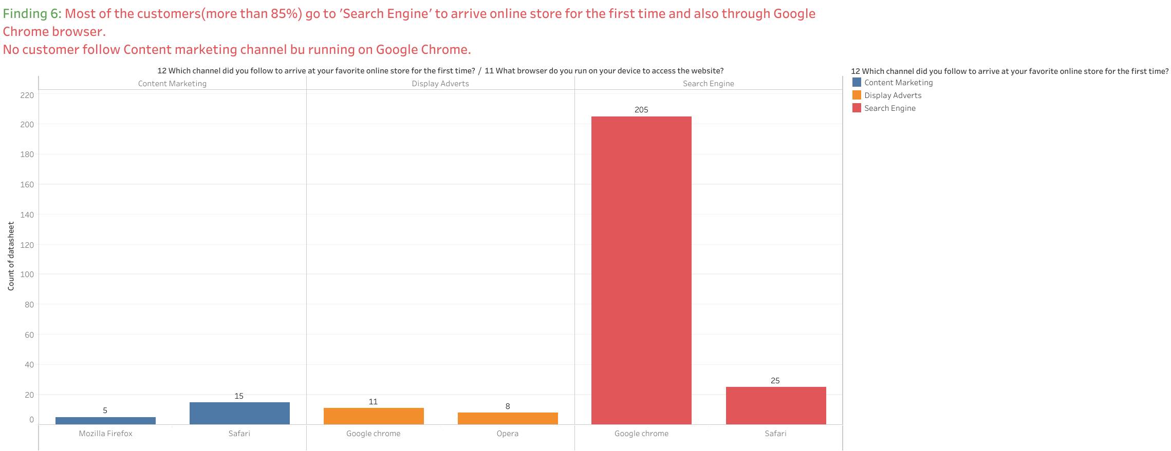

Slide 12
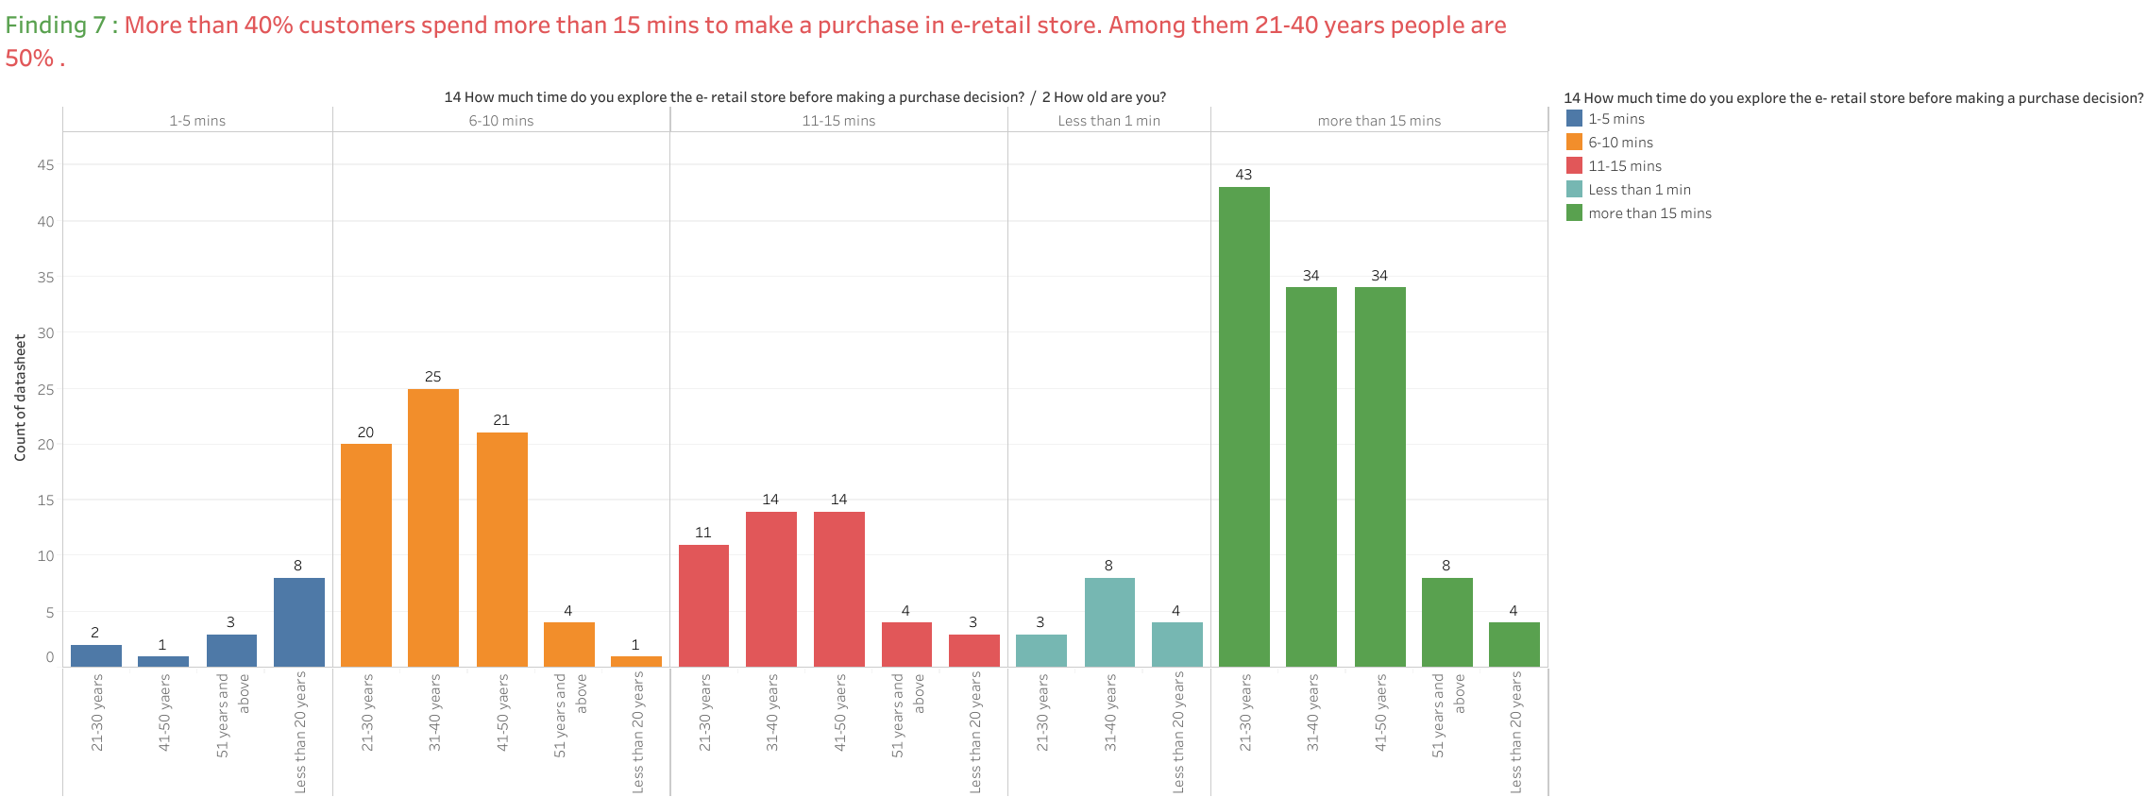

Slide 13
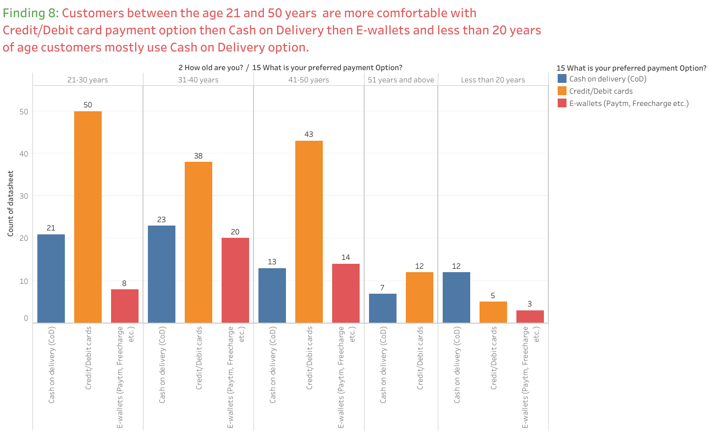

Slide 14
There are few features in the website or application like:
The content on the website must be easy to read and understand
Ease of navigation in website,
User friendly Interface of the website,
Convenient Payment methods,
Trust that the online retail store will fulfill its part of the transaction at the stipulated time,
Empathy (readiness to assist with queries) towards the customers,
Being able to guarantee the privacy of the customer,
Responsiveness, availability of several communication channels (email, online rep, twitter, phone etc.),
Shopping online is convenient and flexible,
Return and replacement policy of the e-retailer is important for purchase decision,
Displaying quality Information on the website improves satisfaction of customers,
User derive satisfaction while shopping on a good quality website or application,
User derive satisfaction while shopping on a good quality website or application,
Provision of complete and relevant product information,
Monetary savings.
are the most important features according to the customers. 50% users from our sample dataset (min 135 out of 269) are strongly agreed that according to them the website with high quality of these features are their preferred e-commerce websites.

Slide 15
Among all the e-commerce companies, customers have shopped from Amazon.co for more times than any other e-commerce companies.
The Second most popular e-retailer company is Flipkart.co.
Other popular websites are used for shopping are Paytm.com, Myntra.com, Snapdeal.com.
From our sample dataset, 82 (more than 30%) customers shop from all 5 online retailers(Amazon.in, Flipkart.com, Paytm.com, Myntra.com, Snapdeal.com).
79 (around 30%) from our 269 customers would like to recommend Amazon.co only to others and 62 people have chosen both Amazon and Flipkart to recommend others for online shopping, then 30 people will recommend both Amazon and Myntra to others.
Around 50 % customers from our sample dataset has stated that in case of Paytm and Snapdeal, the delivery period is longer, that’s the reason that these two are not in people’s recommending choices.

Slide 16
DATA PREPROCESSING
The Complete data is divided in the ration of 70:30 for train and test respectively.
There is no null value present in the dataset and almost all the columns type is objective so we don’t need to check for outliers.
Once our data is ready categorical variables are converted into the numeric form, which we can apply further on algorithms.
I have not dropped any column since the model accuracy is good.

Slide 17

EVALUTION PROCESS
Evaluation Matrices:
Accuracy - it determines how often a model predicts default and non default correctly.
Precision-it calculates whenever our models predicts it is default how often it is correct.
Recall- Recall regulate the actual default that the model is actually predict.
Precision Recall Curve - PRC will display the tradeoff between Precision and Recall threshold.
Cross Validations:
K Fold cross validations , K = 5

Slide 18
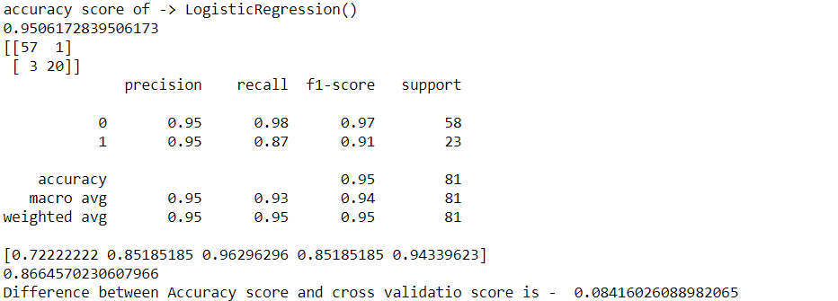
Logistic Regression

Slide 19
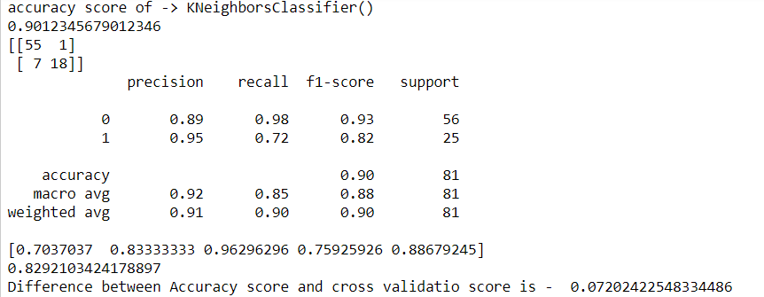
K-neighbors Classifier

Slide 20
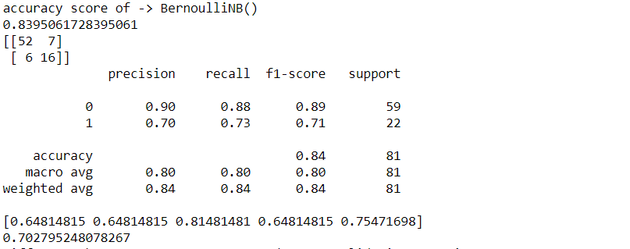
Bernoulli NB

Slide 21
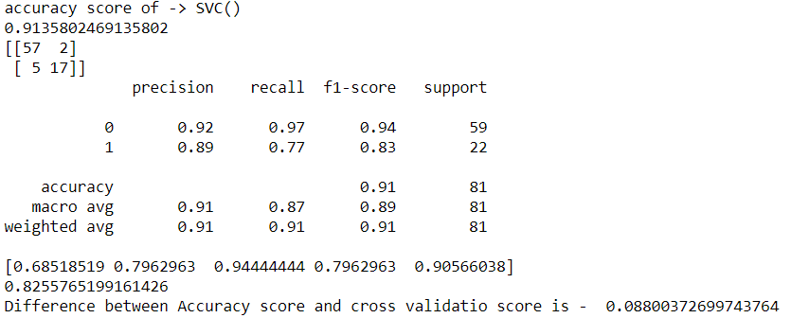
SVC

Slide 22
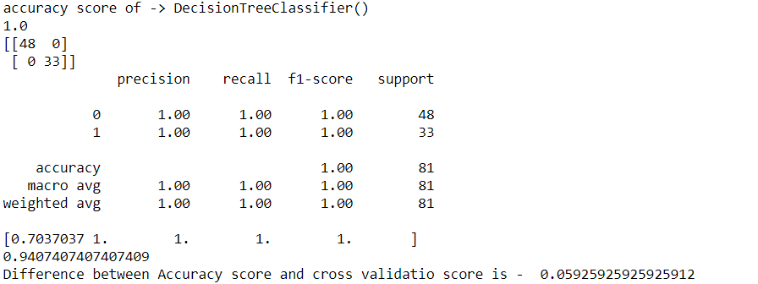
Decision Tree Classifier

Slide 23
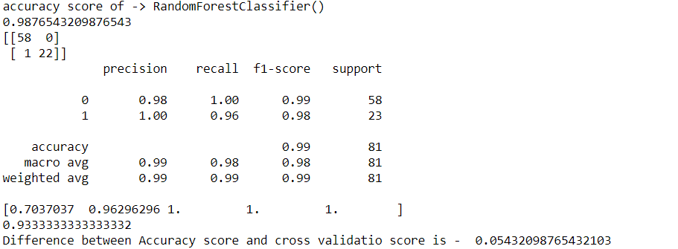
Random Forest Classifier

Slide 24
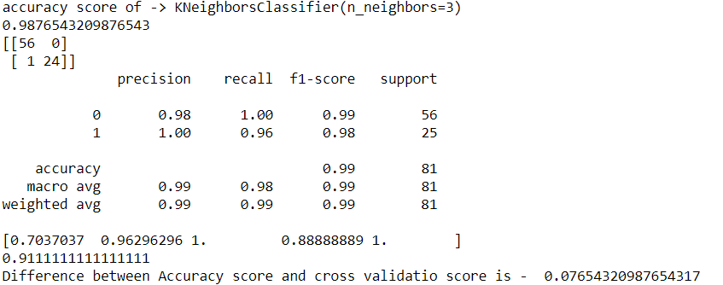
K neighbors Classifier (n_neighbors=3)

Slide 25
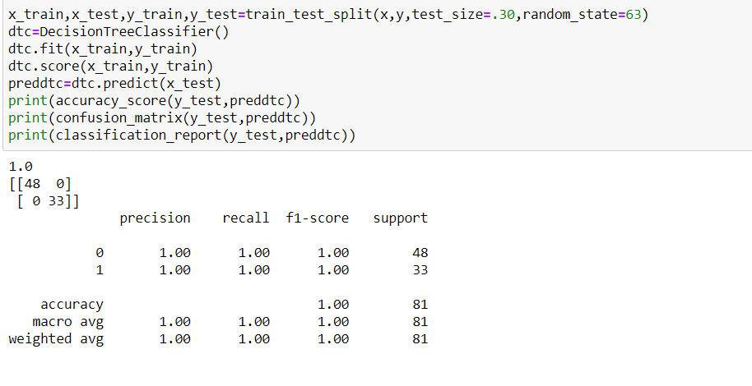
RESULT
From the details on the above solutions it is clearly understandable that we are getting best result with the help of Decision Tree Classifier, so we save this model with the help of joblib Library.

Slide 26
CONCLUSION
According to Marketing Metrics, the chance of making a sale with a new consumer is between five and 20 percent while the odds of selling to a customer who has already made a purchase from you is between 60 to 70 percent. It’s noticeably easier to convince existing customers to buy your products.
All the features or properties that customers are agreed strongly, should be improved and needed more monitoring so that it can reach to customer’s expectation level. Some other tools also could be incorporated to make the experience of customers more joyful and unique, which can encourage customers to spend more time in the website.
Most of the customers are in the age group between 20 to 40 years, so companies can introduce some loyalty program specially designed for this age group customers.
Analyze the good thoughts from customers about the website, find out updated information about why customers visit your ecommerce site, what they hope to accomplish there, what they’re searching for, and also the barriers they find to ordering from you.
Develop a loyalty program. Make sure your customers know you appreciate their business. Reward them for repeat orders.

Slide 27

THANK YOU

